Slide 1

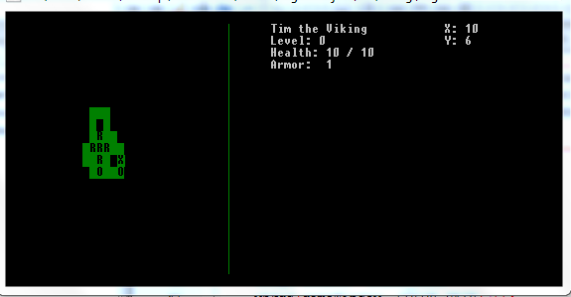
The Labyrinth
Computer Science 240
Project by Alex Griffith, Aaron Martin, and Ashley Phillips
Concord University, Computer Science Department
Spring 2014
Abstract
Object-Oriented Programming
What's Next?
Our project is to create a Rogue-Like game using the C++ Programming Language and the PDCurses library. A Rogue-Like is a Role-Playing game that features random level generation and permanent death. The most famous example of a Rogue-Like is a game called Nethack, available for everyone to download and try. This game makes use of object-oriented programming, inheritance, and polymorphism.
Our game features item generation, random map selection, and player/monster combat featuring unique abilities for each unique class.
Our game makes use of a concept known as Object-Oriented Programming. This concept allows us to create different objects that have their own distinct features and data associated within them. This allows us to simulate different concepts and associate behaviors and information about them. To give you an example, imagine that we have created an object called “Person” and this person stores the data of “Name”, “Age”, and also carries functionality such as “Run” or “Eat.” Objected Oriented Programing allows to do to accomplish such a thing.
There are a ton of features that we wanted to include with the project that we were not able to develop before our display today. Some ideas include more classes, more enemy types, more dynamic levels and so much more. This project may be expanded as a summer project and may be upgraded to include SDL, a graphics library used a lot of today's game development.
Construction
Acknowledgments
Characters
To construct a program of this type, we had to separate this project into pieces. Object-Oriented Programming allows us to separate and build each piece separately in the form of objects. Each object in our project controls a specific attribute of it: Player, Enemies, Items, and Windows. The player class and the enemy class share attributes from the Character class through a method called inheritance. Once created, they can have there own unique functionality that only they should have. They are all built to operate by themselves so we say that the program has loose coupling. We bring all the pieces together and allow them to interact to form the game that you see before you.
We would like to acknowledge the creators of PDCurses, located on SourceForge. We would also like to acknowledge the creators of Nethack and other Rogue-like games that help developed our vision of the game. We'd also like to thank Mr. Bowe who is the big man of the Computer Science Department.
Player
Enemies
References
Code Complete: A Practical Handbook of Software Construction 2nd Edition by Steve McConnell
PDCurses, the graphics library:
http://pdcurses.sourceforge.net/
Nethack, the Rogue-Like of Rogue-Likes:
http://www.nethack.org/
Game
Windows
Items
Early Development of Sokoban Level, a type of puzzle involving the movement of rocks.
Our pictorial representation of the various objects used in our game

